Slide 1
Java Data structures & benchmarking

Slide 2
Objectives of the project
adt-implementations
implement some of the adt we was introduced during the informatics course of my bachelor degree in computer engineering
benchmarks
Compare the data obtained from the experimental analysis (benchmark) with the theoretical performances of the data structures

Slide 3
Table of contents
01
ADTs & Data structures
Introduction to Abstract Data Types & implementations
02
Data structures & complexity
Overview of the performances analysis
03
Benchmarking
Introduction to benchmarking with JMH

Slide 4
01
ADTs
&
Data structures

Slide 5
What are they
ADT
Format of the stored data
Operations that can be performed and the necessary informations to carry them out
Abstract Data Type is an abstract representation of a Data Structure.
It specifies:
Data structure
Containers that organize data in a specific format, designed to meet different needs of:
Construction and access time
Memory occupation

Slide 6
Common ADTs
Stack
Set
Manage data based on Last In–First Out. The only accessible data is the first one to pop.
Container of distinct objects.
Queue
Dequeue
Manage data based on First In-First Out. The only accessible data is the first one to dequeue.
Objects are inserted and extracted at both ends of a linear arrangement.

Slide 7
Common ADTs
Associative ADTs
Map | Realize a biunivocal mapping function between the key set and the value set.
Dictionary | Realize a mapping function between the key set and the value set.
Table | It's a biunivocal mapping between values and numeric keys. The key variability range must be known a priori.
HashTable | Given a table with a fixed dimension, keys outside the key variability range are mapped to a valid index for the table using a Hash function.

Slide 8
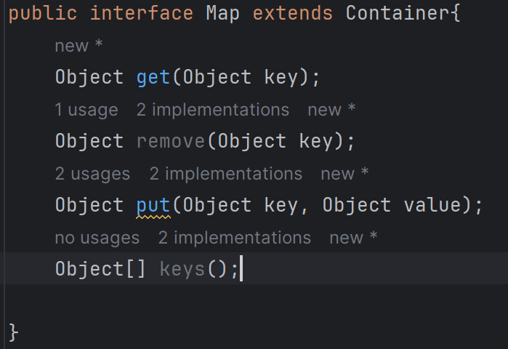
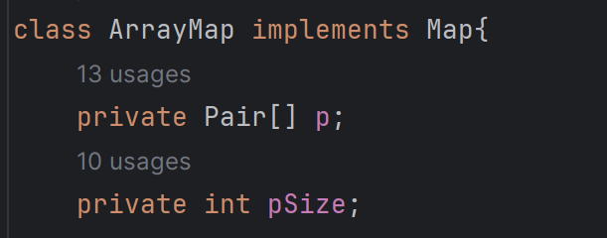
In Java
ADTs
are defined via Java interfaces that define the general behaviour of data structures
Data structures
are defined via Java classes that implement the behaviour defined by the ADTs

Slide 9
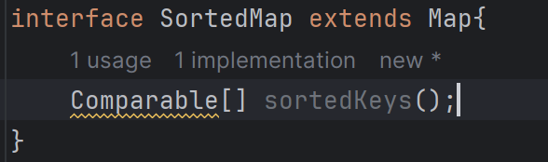
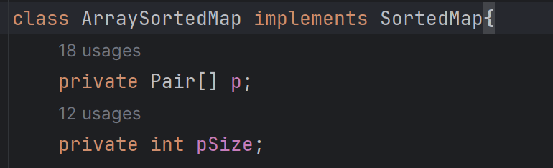
ArrayMap & ArraySortedMap
implements
Inherits Map’s behaviour; objects are kept sorted.
<interface>
SortedMap
ArraySortedMap
extends
implements
<interface>
Map
ArrayMap
extends
Methods of SortedMap’s implementations are designed to only accept Object keys that implements the Comparable interface
<interface>
Container

Slide 10
02
Data structures
&
complexity

Slide 11
Data structures performances
Performances
Measure an algorithm's
execution time over datasets of different sizes
depends on the actual implementation of the data structure,
NOT on the abstract behaviour defined by the ADT
Experimental
Performance analysis
Measured in:
Execution time
Memory occupation
Theoretical

Slide 12
Theoretical analysis
It is a qualitative type analysis based on type and frequency of operations.
It allows to:
01
Retrieve performance informations without actually implementing the algorithm
Assuming that the execution time depends on:
01
02
Base steps number
02
Compare algorithms
Dataset size (n)
03
03
Dataset values
Classify algorithms into complexity classes

Slide 13
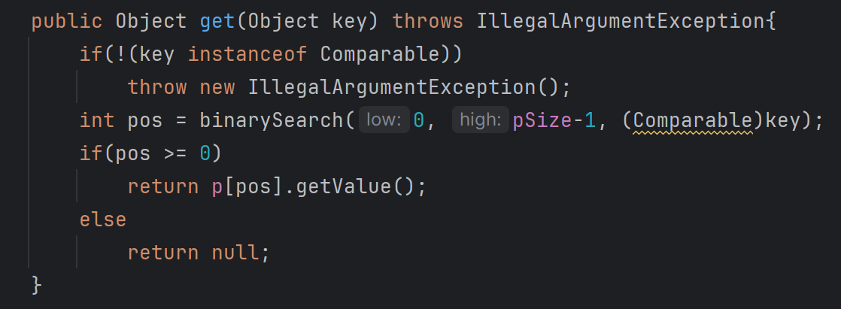
Asymptotic notations
Base steps = 1 + log2(n) + 2
ArraySortedMap
1
Operations with execution time which is:
Constant
Independent from size and values of data
log₂(n)
2
Big-O notation
Starting from the expression that counts the basic steps in terms of size of the input n:
Only the dominant term is taken into consideration
Multiplicative constants are ignored
Logarithms bases are omitted
O(log(n))

Slide 14
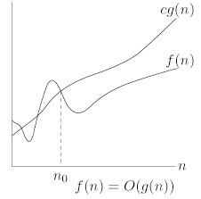
Big-O notation
Definition
f(n) ∈ O(g(n)) if
∃c >0, ∃n0 > 0 : f(n) ≤ c*g(n) ∀n > n0
Asymptotic upper limit
Increasing terms of complexity:
O(1) ∈ O(log(n)) ∈ O(n) ∈ O(nlog(n)) ∈ O(n²) ∈ O(2^{n}) ∈ O(n^{n})

Slide 15
ArrayMap & ArraySortedMap theoretical performances
By keeping unsorted data we can only perform a linear search
 | put() | get() | remove()
ArrayMap | O(n) | O(n) | O(n)
ArraySortedMap | O(n) | O(log(n)) | O(n)
By keeping sorted data we can perform a binary search
Keeping sorted data worsens the put() and remove() performances

Slide 16
Theoretical analysis application example
Given an algorithm whose complexity is O(n²):
For n=10, execution time T=30sec
For n1=20, T1=?
n1 = 2 * n
n1² = (2*n)² = 4n²
If for n² the algorithm execute in time T,
for 4n² the algorithm execute in time 4T.
T1 = 4*T = 4*30sec = 120sec

Slide 17
03
Benchmarking

Slide 18
Benchmark & Microbenchmark
Benchmark
Typically refers to the process of comparing the performance, efficiency, or quality of a whole system against established standards or other entities.
Microbenchmark
Focuses on the performance measurement of small, specific units of code or functions within a larger system. It is particularly useful during the development and optimization phase.

Slide 19
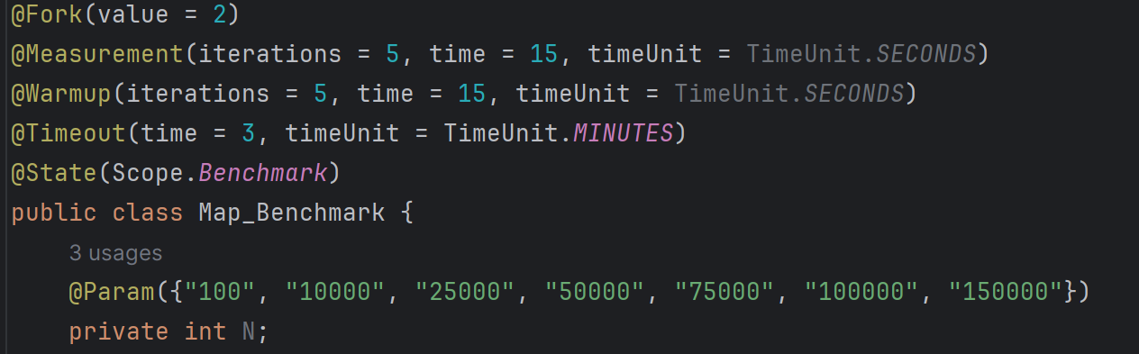
Java Microbenchmark Harness
JMH
JMH is a Java harness for building, running, and analysing nano/micro/milli/macro benchmarks written in Java and other languages targeting the JVM.
We can define benchmark methods (within benchmark classes) on which JMH will perform benchmarks.
We can set the benchmark specifications via jmh annotations.

Slide 20
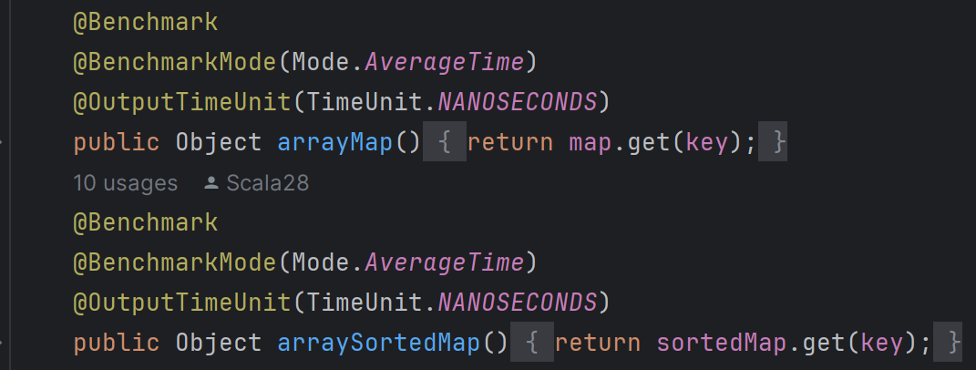
Map_Benchmark class
Comparison between the ArrayMap.get() and ArraySortedMap.get() methods.
Specifications
A benchmark trial is run for every value of param.
5 warm up iterations and 5 measurement iterations are performed for every trial.
Each iteration lasts 15 seconds during which the measurements are repeatedly executed.
The benchmarks measure the average execution time in nanoseconds
The key Object is randomly generated within the range of existing keys before every iteration

Slide 21
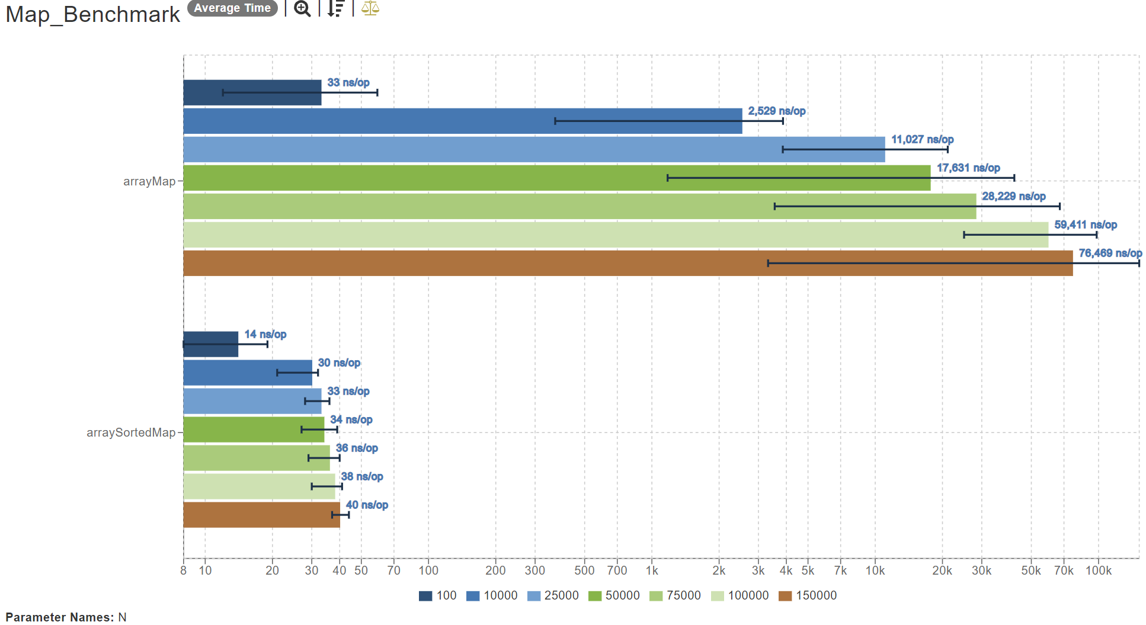
Map_Benchmark results
The benchmark run produces a .json result file containing detailed output informations for every benchmark method.
.json result files can be visually represented by the JMH Visualizer: a simple online graphic tool.

Slide 22
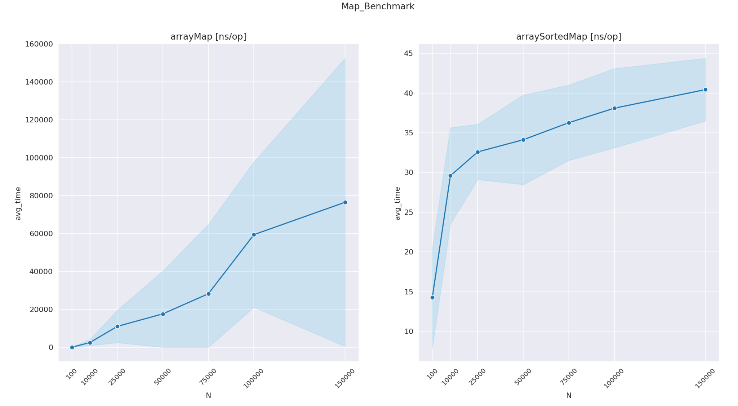
Custom jmh-visualizer
JMH Visualizer result’s representation did not satisfied me, so I included in the project my custom jmh-visualizer: a python project designed to visually represent my personal .json result files and produce charts using python’s matplotlib and seaborn libraries.
Light blue regions represent the confidence interval calculated by jmh.

Slide 23
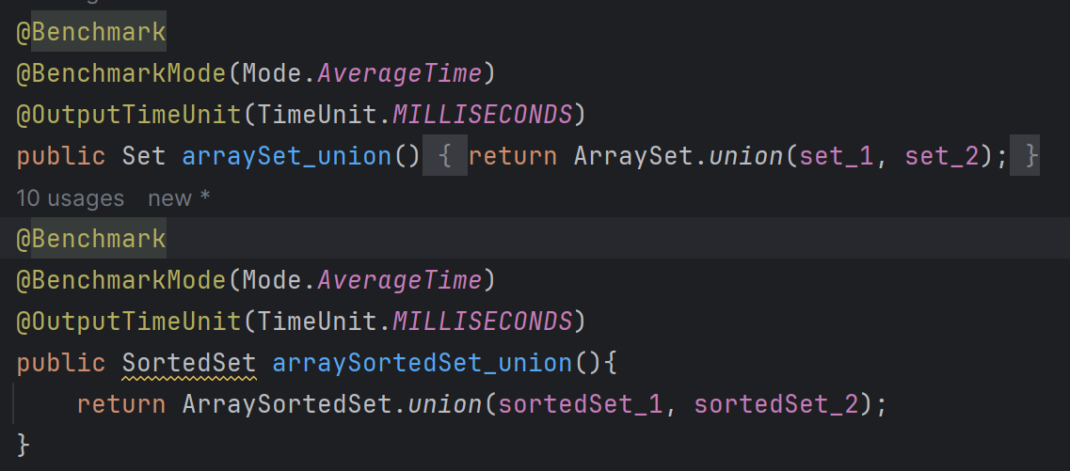
Set_Benchmark class
Comparison between the ArraySet.union(), .intersection(), .subtraction() and ArraySortedSet.union(), .intersection(), .subtraction() methods.
Specifications
I kept the same specifications used for the Map_Benchmark class.
The benchmarks measure the average execution time in milliseconds
Set_1, set_2, sortedSet_1 and sortedSet_2 are made empty and filled by a list of random integers before every benchmark trial.

Slide 24
ArraySet & ArraySortedSet theoretical performances
 | intersection() | subtraction() | union()
ArraySet | O(n²) | O(n²) | O(n²)
ArraySortedSet | O(nlog(n)) | O(nlog(n)) | O(nlog(n))

Slide 25
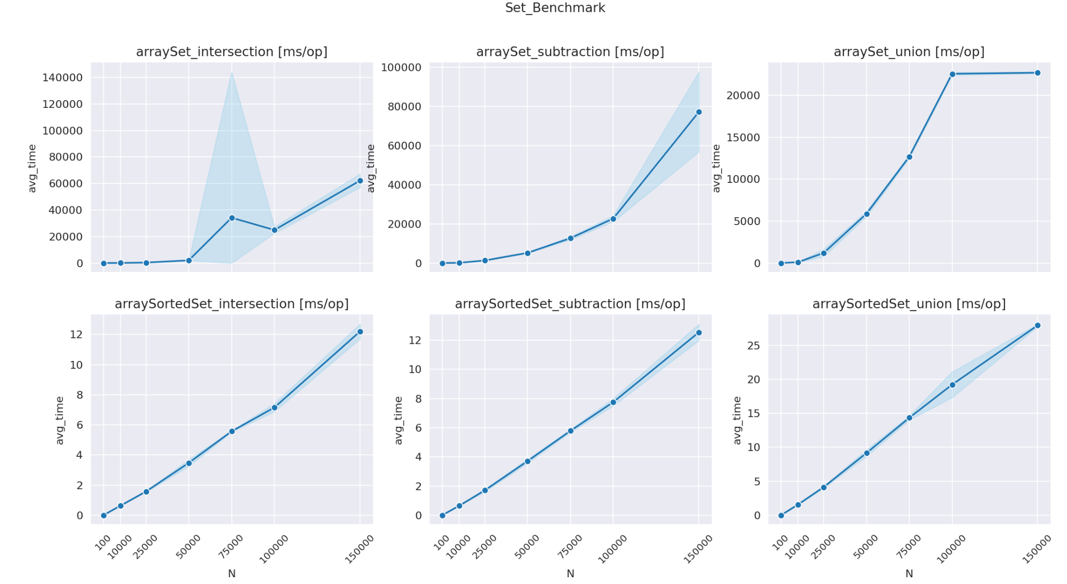
Set_Benchmark results

